Slide 1
Network Attendance Briefing
Autumn Term 2022
Notes:
Team logo(s) to only appear on 1st and last slides.
Only SIL logo to appear on all other slides.
Headings are Calibri body 36 BOLD
Body text is Calibri body 16 regular
Text colour: RGB – 38, 52,105 (dark blue) or 82,42,121 (dark purple). THIS IS DYSLEXIA FRIENDLY
If you wish to change the background colour, we suggest an off-white or a light yellow.

Slide 2
Introductions
Carolyn Harkness:
School Improvement Officer: Attendance
Carolyn.Harkness@si.liverpool.gov.uk
Tel: 0151 233 3901
M: 07802561928
Twitter: @SIL_Attendance

Slide 3
Autumn briefing 2022
Health check
Updates on data
Expectations around data analysis
Information about COPP
School process

Slide 4
New DFE Guidance 6th May 2022
On 6 May 2022, the Department for Education released new non-statutory guidance “Working together to improve school attendance” to help schools, trusts, governing bodies, and local authorities maintain high levels of school attendance and improve consistency of support.

Slide 5
What does this mean for schools?
All schools will be required to:
Have a Senior Attendance Champion on the leadership team- (Designated attendance Lead DAL)
Have a clear school attendance policy published on their website
Have robust day to day processes for recording, monitoring and following up attendance
Analyse their data regularly and prioritise families to work with to understand and address the reasons for absence, including any in-school barriers to attendance.
Work with local partners to remove out of school barriers and act as the lead professional where they are the best placed service
Work jointly with the local authority on an agreed approach/ plan for every severely absent pupil
Develop strategies for cohorts of pupils with poorer attendance than their peers (including groups of vulnerability)
Inform a pupil’s social worker if they have an unexplained absence or leave the school
roll

Slide 6
What does this mean for local authorities?
Local authorities are expected to:
Rigorously track local attendance data to devise a strategic approach to attendance
This strategy should prioritise pupils, pupil cohorts and schools on which to provide support to and focus it’s efforts on to unblock area wide barriers to attendance.
Recognise the importance of attendance and understand how attendance improvement is everyone’s business.
Make attendance a key focus of all frontline council services.
Use attendance data from all schools in the area to identify the pupil cohorts, schools, and neighbourhoods/ towns on which to focus efforts.
Use this analysis to set a clear vision for improving attendance across the geographical area, underpinned by tangible short and longer term aims and priorities for improving attendance for particular cohorts of pupils identified.
All appropriate frontline operational staff in attendance, associated teams and local partners must understand their role in delivering this strategy and working together.
Evaluate and review this strategy regularly. This should involve senior officers and lead members.

Slide 7
Coding advice
Your EWO is your professional point of contact for all coding questions.
N codes should only be used for up to 5 days
X codes should no longer be used
Fixed Penalty notice paperwork must be put in no longer than 10 days after the holiday.

Slide 8
Liverpool Data-Autumn and Spring combined 2021/22
Sector | Absence | PA
Primary | 5.9% | 17.6%
Secondary | 10.1% | 31.3%
Special | 13.7% | 39.0%

Slide 9
Current Liverpool Data-1.9.22 to 7.10.22
Sector | Absence | PA | SA
Primary | 4.8% | 15.3% | 0.7%
Secondary (2 dis ag) | 7.4% | 20.1% | 3.3%
Special | 10.6% | 27.0% | 5.4%

Slide 10
Liverpool Primary Statistics

Slide 12
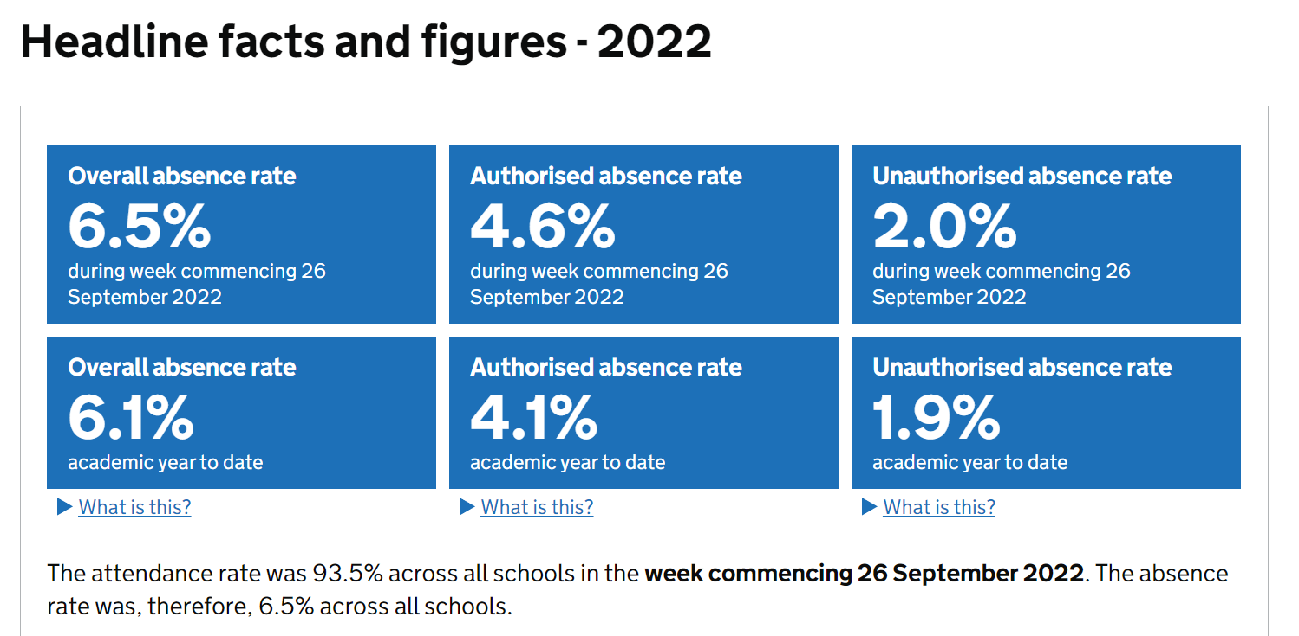

Slide 13
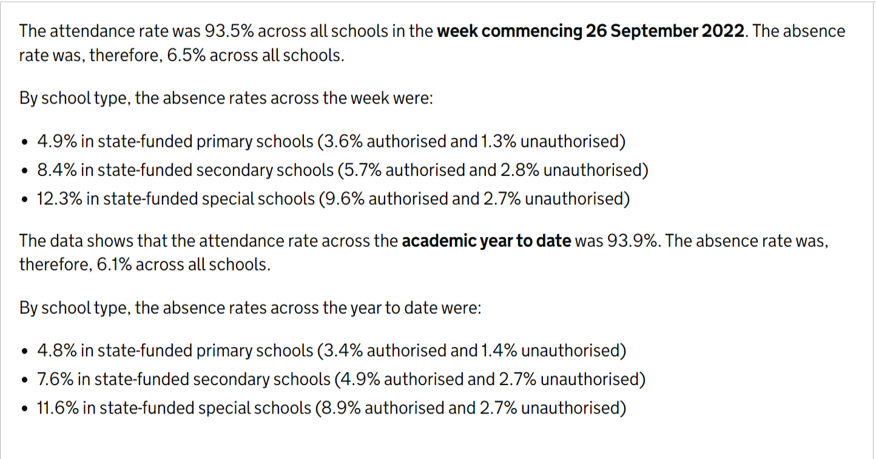

Slide 14
DFE Data update
INFORMATION: Schools can now compare attendance with national, regional and local authority figures and view last year’s attendance
From Thursday 29 September, schools and local authorities can use a public data dashboard to compare themselves with up-to-date national, regional and local authority figures for pupil attendance and absence in England. This will be updated every 2 weeks.
In addition to daily attendance reports for the new academic year, schools, local authorities and trusts can use their school daily attendance reports to view a summary of their overall attendance for the 2021/22 academic year and attendance for each pupil.

Slide 15
Margin data
Are you looking at it every week?
What are you doing about it?
Share good practice.

Slide 16
Margin Data- Autumn and Spring combined
Autumn and Spring Terms 2021/22 |  | If extra days attendance |  |  | Difference
 | PA | 1 day | 2 day | 3 day | 1 day | 2 day | 3 day
Primary | 17.6 | 15.1 | 13.2 | 11.6 | 2.5 | 4.4 | 6.0
Secondary | 31.3 | 28.4 | 25.9 | 23.7 | 2.9 | 5.4 | 7.6
Special | 39.0 | 36.5 | 34.2 | 32.4 | 2.5 | 4.8 | 6.6
PRU | 72.7 | 67.9 | 65.1 | 62.2 | 4.8 | 7.7 | 10.5
All Sectors | 24.2 | 21.5 | 19.4 | 17.5 | 2.7 | 4.9 | 6.8

Slide 17
Working together to improve attendance
Expect- Aspire to high standards
Monitor- Rigorously use attendance data to identify patterns at individual and cohort level.
Listen and understand
Facilitate support- this might include early help where absence is a symptom of wider issues
Formalise support- partners should work together to explain the consequences of absence and ensure support is in place
Enforce- Where all avenues have been exhausted , enforce attendance through statutory intervention.

Slide 18
The DFE Guidance
Regularly analyse attendance and absence data to identify pupils or cohorts that require support with their attendance and put effective strategies in place
As poor attendance is habitual, prevention and early intervention is crucial. The key to this is regular data analysis to both identify and provide immediate additional support to pupils or pupil cohorts that need it, and to look at historic and emerging patterns across the school and develop strategies to address them. To achieve this all schools are expected to:

Slide 19
The DFE Guidance
Monitor and analyse weekly attendance patterns and trends and deliver intervention and support in a targeted way to pupils and families. This should go beyond headline attendance percentages and should look at individual pupils, cohorts and groups (including their punctuality) across the school to help schools achieve their responsibilities under the Public Sector Equality Duty.
When analysing patterns, some schools, especially secondary schools, may wish to look further into patterns of attendance within a session to ensure all pupils are attending all timetabled lessons.

Slide 20
The DFE Guidance
Use this analysis to provide regular attendance reports to class teachers or tutors to facilitate discussions with pupils and to leaders (including any special educational needs coordinators, designated safeguarding leads and pupil premium leads).
Identify the pupils who need support and focus staff efforts on developing targeted actions for those cases (see paragraphs 34-39).
Conduct thorough analysis of half-termly, termly, and full year data to identify patterns and trends. This should include analysis of pupils and cohorts and identifying patterns in uses of certain codes, days of poor attendance and where appropriate, subjects which have low lesson attendance.

Slide 21
Process- strategic, robust, rigorous
First response. Is it preventing or reacting to?
What time are all children accounted for ?
What happens then? Strong, determined strategic informed decision making. No drift.

Slide 22
Focus
No drift
No overlap
Who is making strategic decisions daily and weekly?

Slide 23
The DFE Guidance
Benchmark their attendance data (at whole school, year group and cohort level) against local, regional, and national levels to identify areas of focus for improvement.
Devise specific strategies to address areas of poor attendance identified through data. This may, for example, include pupils in a year group with higher than average absence or for pupils eligible for free school meals if their attendance falls behind that of their more advantaged peers
Monitor in the data the impact of school wide attendance efforts, including any specific strategies implemented. The findings should then be used to evaluate approaches or inform future strategies.

Slide 24
Actions:
Run a G code report
How much time has been lost?
What % of absence is unauthorised?
Add SA (severely absent) to your data analysis
Look at broken weeks
Look at your sporadic absence
Provide regular attendance reports
Know where you are now compared with this time last year.

Slide 25
School Process
How are you increasing your level of support?
Initial information gathering
Support meetings
Referral to multi agencies
How are you increasing your level of challenge?
Using % attendance during phone calls?
Following up every unauthorised absence.

Slide 26
Support meeting 1
Find out what the problems are
How can we support you to bring your child to school every day?
Record the responses and actions accurately.
Put support in place.

Slide 27
Support meeting 2
This takes place after the next unauthorised absence
Review meeting one
Discuss further problems
Consider referrals
Consider an EHAT
Share information when appropriate
Record accurately

Slide 28
Challenge – meeting 3
To be held after next unauthorised absence
Discuss reasons for absence
Is more support needed?
Explain escalation process
Do not tolerate poor attendance
Discuss with your EWO for advice and guidance

Slide 30
Weekly use of data
Attendance % for the week. Attendance and PA % year to date.
Best and worst attended weeks for the year. Plan your year around them.
PA list 90% and below.
Look at list and action every child in % bands
Use individual data
90-92% list – Be proactive. Act now to prevent children becoming PA.
93-95%- Look for patterns and broken weeks. How can you improve this cohort to reach 97%?
Share data with all staff and children

Slide 31
Half termly and termly
Analyse by vulnerable groups. Worst attending group?
What actions are in place for each group of children?
Senco action plan for attendance of SEND children.
PP action plan for attendance of dis-advantaged children.
All stakeholder’s should be aware of half termly attendance profile.
Re state all roles and responsibilities.
Look at impact of incentives. Plan next incentive.
Analyse 90-92%. Be proactive!
Analyse PA. How many children can come out of PA?

Slide 32
Annually
Whole year attendance profile
Groups- including safeguarded groups
Actions for next year
Transition data
Appropriate challenge from Governors

Slide 33
Policy documents
Updated attendance templates can be found here.
Template Attendance Policy- Primary and Special
Template Attendance Policy-Secondary and Special
Attendance Management Plan (AMP)
EWS referral form

Slide 34
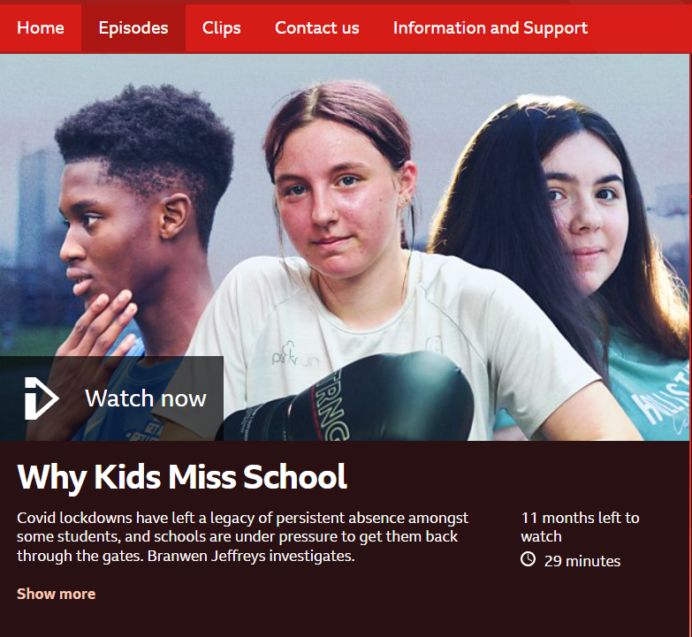
BBC Panorama
https://www.bbc.co.uk/programmes/m001c9zw

Slide 35
Children Out of Provision Panel- COPP
Established in Feb 21
Meets fortnightly
Reports to Attendance Strategy Group
Members:
Chaired by SEND partnership co-ordinator
Service Manager for EHE, Attendance and CME – SIL
CME co-ordinators
AEP Business Manager
LSCP Education Officer
Admissions –
Pupil Place Planning and Access Manager
School Admissions Inclusion Co-ordinator

Slide 36
Which pupils?
Without a school place (WASP) cohort
Admissions – pupils not placed after 20 days
Children missing education (CME) cohort
Pupils currently on a reduced timetable
FAP

Slide 37
WASP(without a school place)
Pupils we know to be living in the city who do not currently have a school place.
Reasons may be:
New to the city – going through the admissions process
Awaiting starting at a provision
Pupils open to admissions not placed after 20 days

Slide 38
CME
Children Missing Education – DfE definition:
Children missing education are children of compulsory school age who are not registered pupils at a school and are not receiving suitable education otherwise than at a school.
Pupils residing in Liverpool (unregistered)
Investigations indicate they are no longer residing in Liverpool (missing)
The process of reducing the missing cohort number is explained in the following flowchart.

Slide 40
Pupils on a reduced timetable
Liverpool’s Policy for reduced timetables criteria are:
As part of a planned re-integration into school following an extended period out of school due to exclusion, non-attendance, school refusal or to facilitate a managed transfer between schools.
As a temporary fixed-term, closely monitored intervention to address and manage the impact of significantly challenging behaviour or emotional or social needs, whilst alternative arrangements are being made to meet the individual needs or to coordinate with therapeutic intervention or other services.
In limited circumstances reduced educational provision may also be used as a method of managing pupils at risk of exclusion.
The agreement must have a time limit by which point the pupil is expected to attend full-time or be provided with alternative provision.
Please use the online form to notify COPP that you wish to place a pupil on a reduced timetable.

Slide 41
In Year Fair Access Protocol
children who have already been out of school for a period of more than two months either on receipt of the application for a place or from the date of application
children from the criminal justice system or Pupil Referral Units or hospital schools who need to be reintegrated into mainstream education
children of Gypsies, Roma, Travellers, refugees and asylum seekers
children who are homeless
children with complex family circumstances for whom a place has not been sought
children who are carers
children with special educational needs, disabilities or medical conditions (but without an EHCP)
year 11 pupils who arrive new to the city after the start of the academic year who cannot be placed through Admissions
permanently excluded pupils
re-integration of permanently excluded pupils, those returning to a mainstream school from a PRU or alternative provision

Slide 42
Ofsted Updates 2022
“A few pupils do not attend school as often as they should. This means that these pupils sometimes miss out on important aspects of their learning. Leaders should ensure that all pupils attend school regularly so that they benefit from all that is on offer.”
published 01/10/22

Slide 43
Making a difference from day one: Top Tips continued….
Build more capacity into your attendance team for A1 if possible.
High impact actions include- daily home visits, attendance panels, SLT meet every PA parent and put an action plan in place.
Be tough, be consistent, no excuses, do not authorise absence unless you are happy it is legitimate. EWS Service can not act on authorised absence.
Be honest and clear with parents and do not shy away from difficult conversations, challenge the culture that disadvantages your pupils.

Slide 44
Impact!
It is all about impact!
With strong, determined leadership and management school should see impact before the end of Autumn term.
Impact statements…

Slide 45
Future Training and support
Full attendance review: Carolyn Harkness
8am to 12.30pm Observation and open dialogue about all attendance processes, data rolls and responsibilities. Future actions agreed upon.
Attendance support visit: Carolyn Harkness
Approximately two hours. Discussion about current practice and how it could be enhanced
Register Inspection: Allison Cain.
Checks full legal compliance

Slide 46
Contact us
0151 233 3901
sil@si.liverpool.gov.uk
www.schoolimprovementliverpool.co.uk
Toxteth Annexe, Aigburth Road, Liverpool, L17 7BN
Did you know that we offer training and consultancy services across all phases and a wide range of subjects?
We are also able to offer bespoke school sessions or one-to-one support via our digital platforms.
Visit www.schoolimprovementliverpool.co.uk/Training
to view our full training offer or email marketing@si.Liverpool.gov.uk.
Join the conversation…

